Slide 1
Android HttpUrlConnection
CIT 360 GROUP 4 EDGAR ROMERO

Slide 2
CODING TOPIC INTRODUCTION
HttpURLConnection
If your application needs to communicate with a web application or service, the natural choice when writing Java is to use the HttpURLConnection
Regardless of which type of communication is being done, you need to understand how sockets work. If you do not you will make engineering and coding mistakes. By making these mistakes your app will consume too many network and computing resources.
This means that your customers will not be satisfied and, given an option, will abandon your application.
References
Doing more with Java, page 63 and 67
httpURLConnection:
https://developer.android.com/reference/java/net/HttpURLConnection
https://www.youtube.com/watch?v=zmigQ4zLTcw
https://www.youtube.com/watch?v=iwyK9S9yMgs

Slide 3
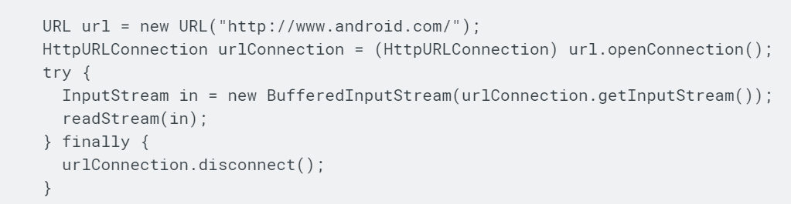
Android HttpUrlConnection
For example, to retrieve the webpage at http://www.android.com/:
Response Handling
HttpURLConnection will follow up to five HTTP redirects. It will follow redirects from one origin server to another. This implementation doesn't follow redirects from HTTPS to HTTP or vice versa.

Slide 4
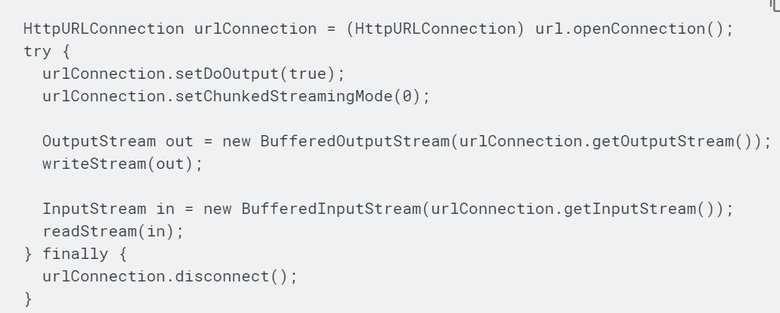
Android HttpUrlConnection
Posting Content
To upload data to a web server, configure the connection for output using setDoOutput(true). For best performance, you should call either setFixedLengthStreamingMode(int) when the body length is known in advance, or setChunkedStreamingMode(int) when it is not. Otherwise HttpURLConnection will be forced to buffer the complete request body in memory before it is transmitted, wasting (and possibly exhausting) heap and increasing latency. For example, to perform an upload:

Slide 5
Android HttpUrlConnection
Each time you click a link in your browser, your browser opens a socked on port 80 and connects to the web server. It then sends a request to the server, waits for a response and closes the socket. HttpURLConnection use this connect many use once approach.
There are advantages and disadvantages to writing your code to be connect may use once. When using this approach you use CPU cycles to create a Socket each time data needs to be sent or retrieved from the server.

Slide 6
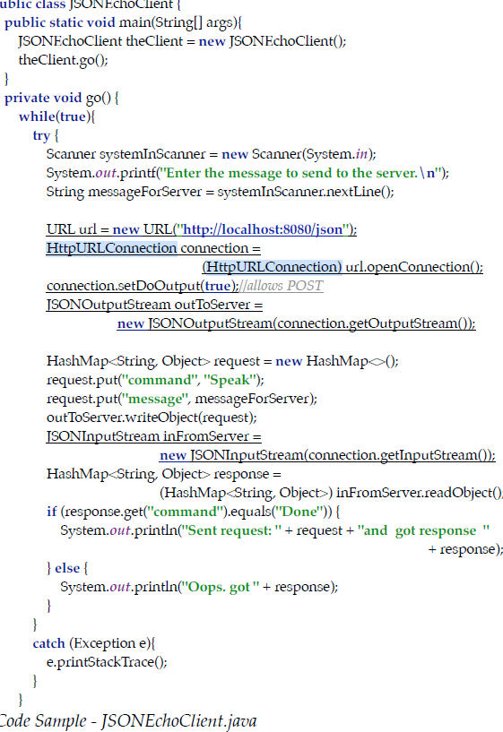
Android HttpUrlConnection – The client
The HttpURLConnection handles the creation of the Socket instance for you. It also has getInputStream and getOutput-Stream methods that will get you these from the socket it created.
So in that way, HttpURLConnection works like Tomcat. However, it won’t create threads and thread pools for you. Be sure to remember this.
One thing to be careful about. Notice that JSONEchoClient doesn’t create an instance of JSONInputStream until AFTER writeObject has been used to send data to the server. This is a limitation of HttpURLConnection. If you try to use HttpURLConnection’s getInputStream method before you send data using it’s output stream your code will fail. Just a head’s up. Be careful.

Slide 7
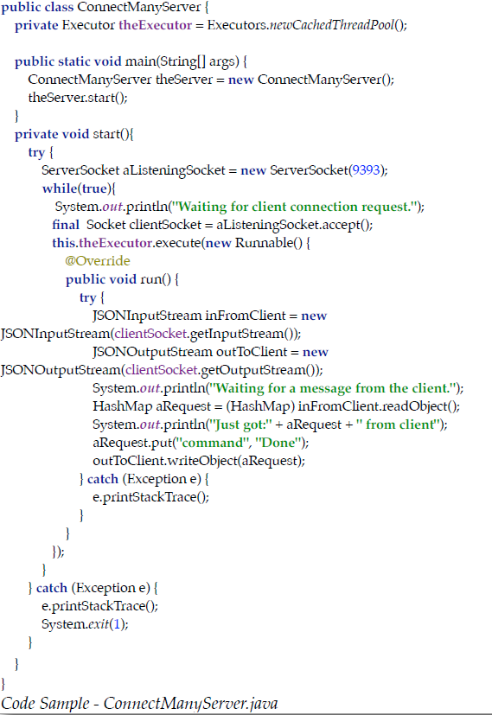
Android HttpUrlConnection – The SERVER
The ConnectManyServer.java code sample is in some ways the inverse of its client. It also has an infinite while loop but instead of writing and then reading using JSON streams, it reads then writes.
This inversion is required since the client writes then reads. Stop and think about this for a while. It takes some pondering.
The ConnectManyServer, unlike the client, is threaded so it can handle connections and requests from multiple clients at the same time.

